Slide 1
COMP 4500
Week 9 - Friday

Slide 2
Last time
What did we talk about last time?
Subset sum
Knapsack

Slide 3
Questions?

Slide 4
Assignment 5

Slide 5
Logical warmup
Consider the following sequence, which should be read from left to right, starting at the top row
1
1 1
2 1
1 2 1 1
1 1 1 2 2 1
What are the next two rows in the sequence?

Slide 6
Back to Knapsack

Slide 7
Knapsack example
Items (w_{i}, v_{i}):
  (7, 9)
  (3, 4)
  (2, 3)
  (6, 2)
  (4, 5)
  (5, 7)
Maximum weight: 10
Create the table to find all of the optimal values that include items 1, 2,…, i for every possible weight w up to 10

Slide 8
Fill in the table
i | w_{i} | v_{i} | 0 | 1 | 2 | 3 | 4 | 5 | 6 | 7 | 8 | 9 | 10
0 | 0 | 0
1 | 7 | 9
2 | 3 | 4
3 | 2 | 3
4 | 6 | 2
5 | 4 | 5
6 | 5 | 7

Slide 9
Three-sentence Summary of Sequence Alignment

Slide 10
Sequence Alignment

Slide 11
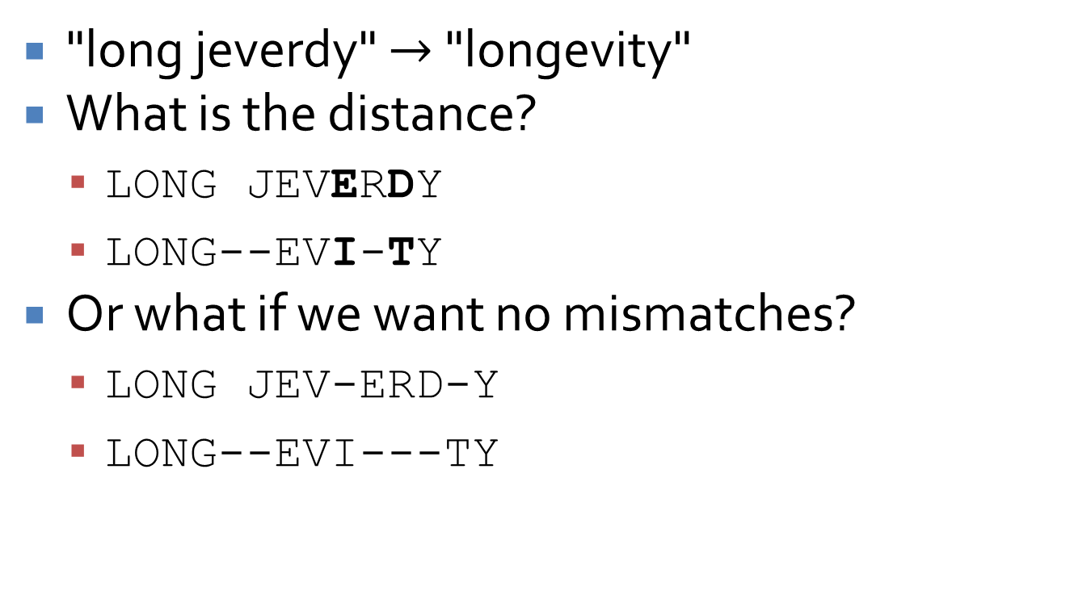
Edit distance between strings
"long jeverdy" $→$ "longevity"
What is the distance?
  LONG JEVERDY
  LONG--EVI-TY
Or what if we want no mismatches?
  LONG JEV-ERD-Y
  LONG--EVI---TY

Slide 12
Edit distance is important
It can be used in a spell-checker (or auto-correct) to suggest similar words
There are applications in DNA analysis:
  How different is this sequence from that sequence?
We want a general metric for handling both gaps and mismatches

Slide 13
Alignment
An alignment is a list of matches between characters in strings X and Y that doesn't cross
Consider:
  stop-
  -tops
This alignment is (2,1), (3,2), (4,3)

Slide 14
Alignment cost
Some optimal alignment will have the lowest cost
Cost:
  Gap penalty δ > 0, for every gap
  Mismatch cost α_{pq} for aligning p with q
    α_{pp} is presumably 0 but does not have to be
  Total cost is the sum of the gap penalties and mismatch costs

Slide 15
Designing the algorithm
We always try to think backwards when doing dynamic programming
Let strings X and Y have length m and n, respectively
In the optimal alignment M, either characters m and n are matched, or they're not
In other words, at least one of the following is true:
  (m,n) is in M
  The m^{th} position of X is not matched
  The n^{th} position of Y is not matched

Slide 16
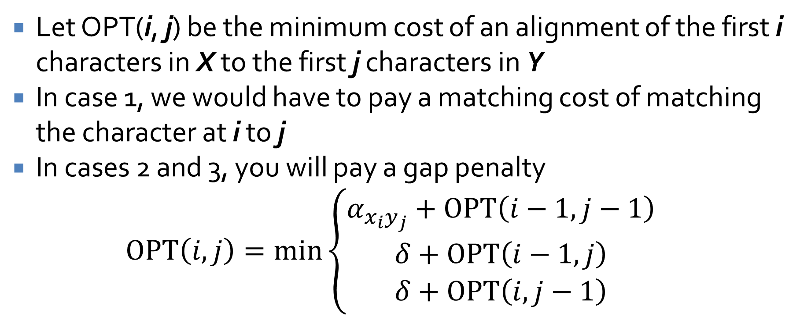
Formulating the recurrence
Let OPT(i, j) be the minimum cost of an alignment of the first i characters in X to the first j characters in Y
In case 1, we would have to pay a matching cost of matching the character at i to j
In cases 2 and 3, you will pay a gap penalty
$$OPT\left(i,j\right)=\min\left\{\begin{aligned}α_{x_{i}y_{j}}+OPT\left(i−1,j−1\right) \\ δ+OPT\left(i−1,j\right) \\ δ+OPT\left(i,j−1\right)\end{aligned}\right.$$

Slide 17
Now what?
We do our usual thing
Build up a table of values with m + 1 rows and n + 1 columns
In row o, column j has value jδ to build up strings from the empty string
In column o, row i has value iδ to build up strings from the empty string
The other entries (i,j) can be computed from (i -1, j – 1), (i – 1, j), (i, j – 1)

Slide 18
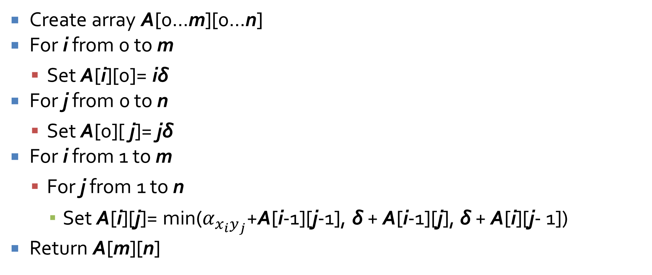
Alignment(X,Y)
Create array A[0...m][0...n]
For i from 0 to m
  Set A[i][0]= iδ
For j from 0 to n
  Set A[0][ j]= jδ
For i from 1 to m
  For j from 1 to n
    Set A[i][j]= min($α_{x_{i}y_{j}}$+A[i-1][j-1], δ + A[i-1][j], δ + A[i][j- 1])
Return A[m][n]

Slide 19
Table A of OPT values
0 | 0 | δ | 2δ | … | (j -1)δ | jδ | … | nδ
1 | δ
2 | 2δ
 | …
i – 1 | (i-1)δ
i | iδ
 | …
m | mδ
 | 0 | 1 | 2 | … | j - 1 | j | … | n

Slide 20
Reconstructing and run-time
As before, we can trace back through the table and find the changes, insertions, and deletes
The running time is O(mn) because the table is O(mn) and we spend constant time on each entry
Because we only need the previous (and current) row, we can reduce the space to O(n), but then reconstructing the solution becomes tricky
  The book explains how such an algorithm can be done, but we won't focus on it

Slide 21
Sequence alignment example
Find the minimum cost to align:
  "anguished"
  "language"
The cost of an insertion (or deletion) δ is 1
The cost of replacing any letter with a different letter is 1
The cost of "replacing" any letter with itself is 0

Slide 22
Fill in the table
 |  | a | n | g | u | i | s | h | e | d
 | 0 | 1 | 2 | 3 | 4 | 5 | 6 | 7 | 8 | 9
l | 1
a | 2
n | 3
g | 4
u | 5
a | 6
g | 7
e | 8

Slide 23
Quiz

Slide 24
Upcoming

Slide 25
Next time…
Maximum-flow problem
Minimum cuts

Slide 26
Reminders
Work on Homework 5
Read sections 7.1 and 7.2

